Slide 1
Decision tree regression using id3 algorithm
~ Suhas D S

Slide 2
Table Of Content:
Importing Libraries
Loading Data
Data Overview
EDA
Preprocessing Data
Splitting Data
Model Building From Scratch
Comparing model with Sklearn model
Hyper parameter tuning
Conclusion

Slide 3
Problem Statement:
Predicting the price of ticket for a flightdataset and developing a Decision tree regression model to predict the Price based on the given features .

Slide 4
Brain Storming
a) Does price vary with Airlines?
b) How is the price affected when tickets are bought in just 1 or 2 days before departure?
c) Does ticket price change based on the departure time and arrival time?
d) How the price changes with change in Source and Destination?
e) How does the ticket price vary between Economy and Business class?, etc

Slide 5
Features of the Dataset
Data is seperated in to two parts:
- one for economy class tickets and another for business class tickets.
A total of 300261 distinct flight booking options are available. And these are for 50 days, from February 11th to March 31st, 2022
Target Variable: price
Problem Type- Regression type

Slide 6

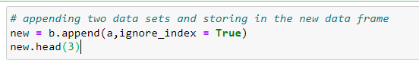
Initial Preprocessing
we will drive new feature named class to specify in which class the ticket is booked

Slide 7
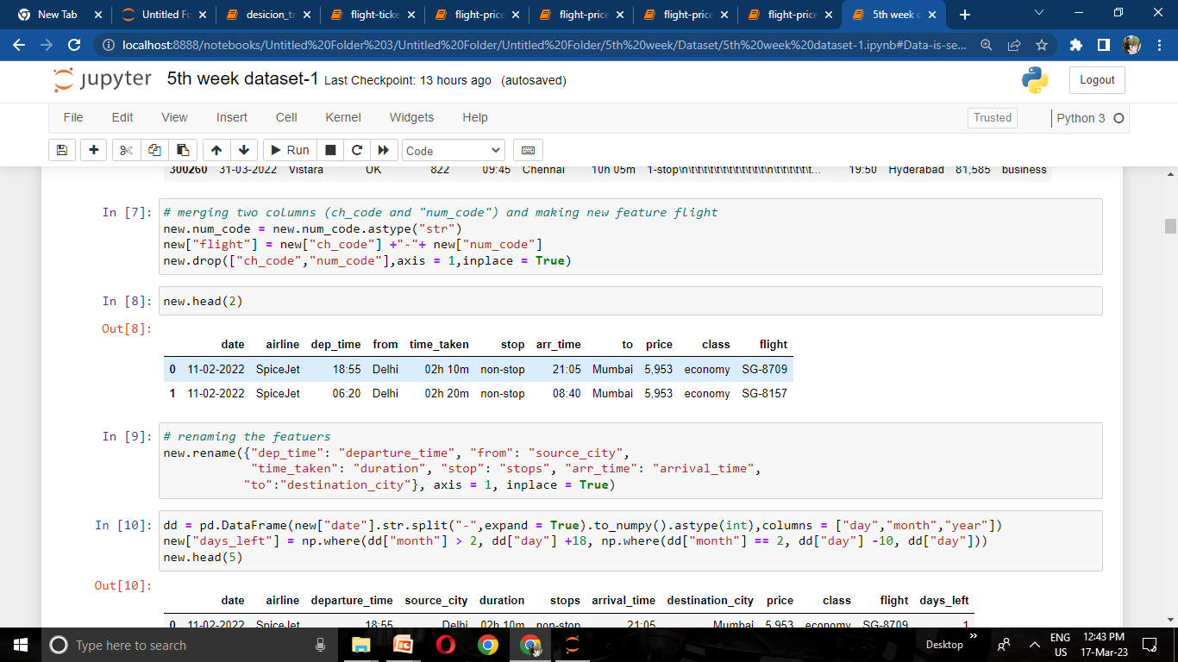
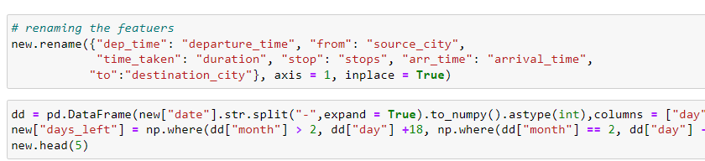
we will drive new feature named flight by adding ch_code and num_code of the flight

Slide 8
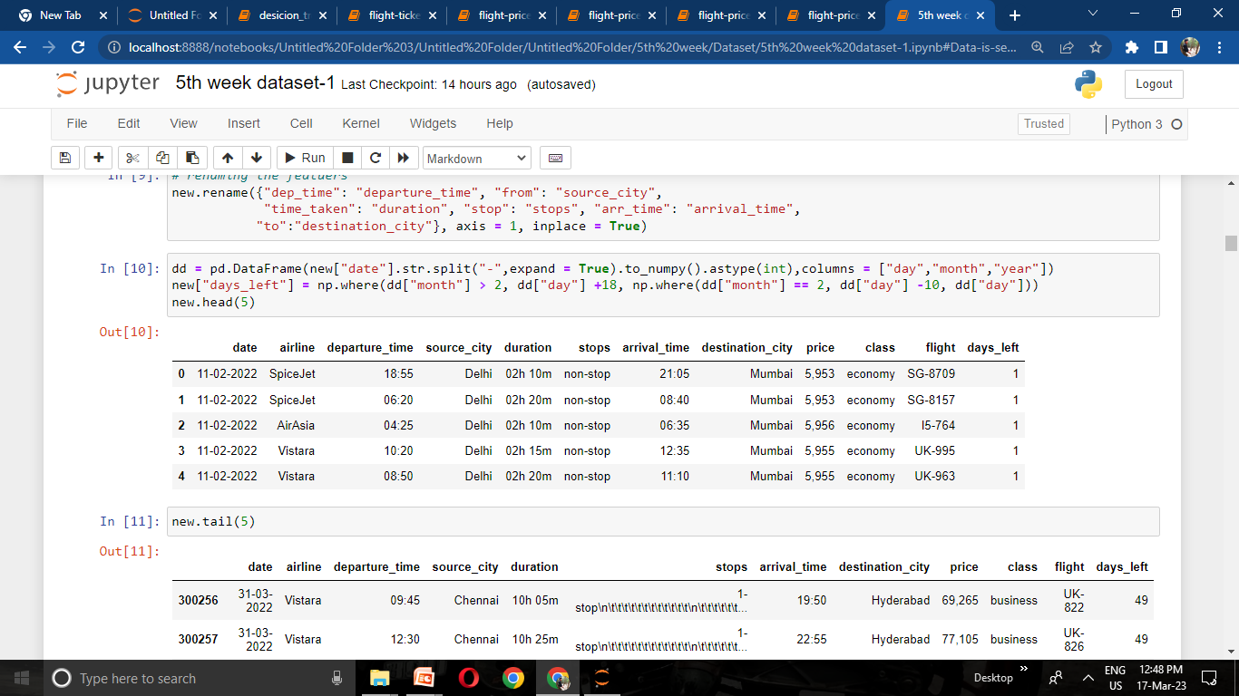
we will drive new feature days left by subtracting the booking date from journey date

Slide 9
Clean Data
Airline
Flight
Source City
Departure Time
Stops
Arrival Time
Destination City
Class
Duration
Days Left
Price

Slide 10
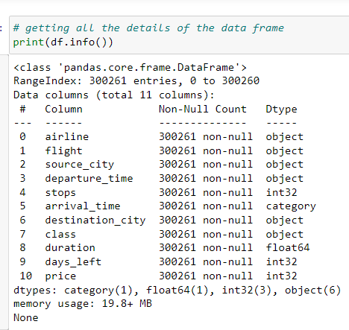
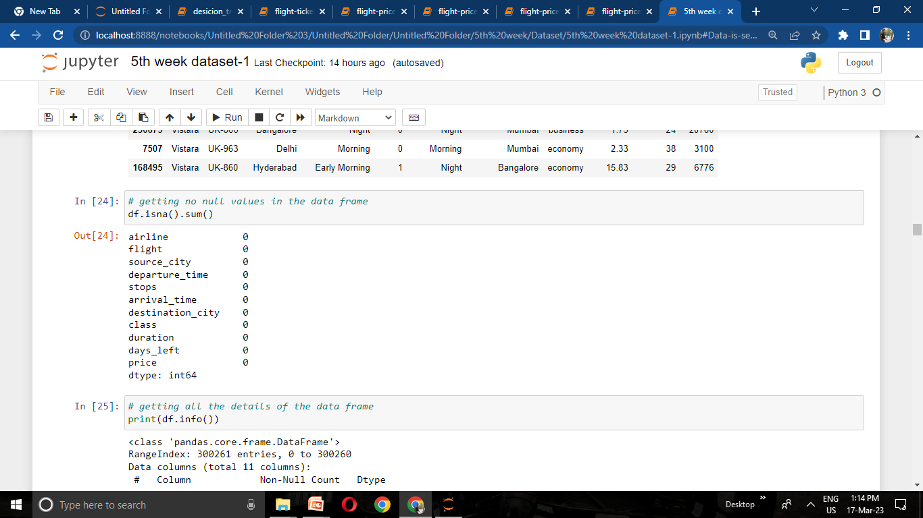
df.info gives the information of the data frame
df.isna().sum() – it shows sum of null values present in our data frame

Slide 11
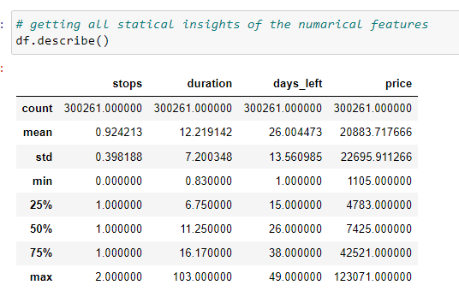
Data.describe() it gives us summary statistics for numerical columns in our dataframe

Slide 12
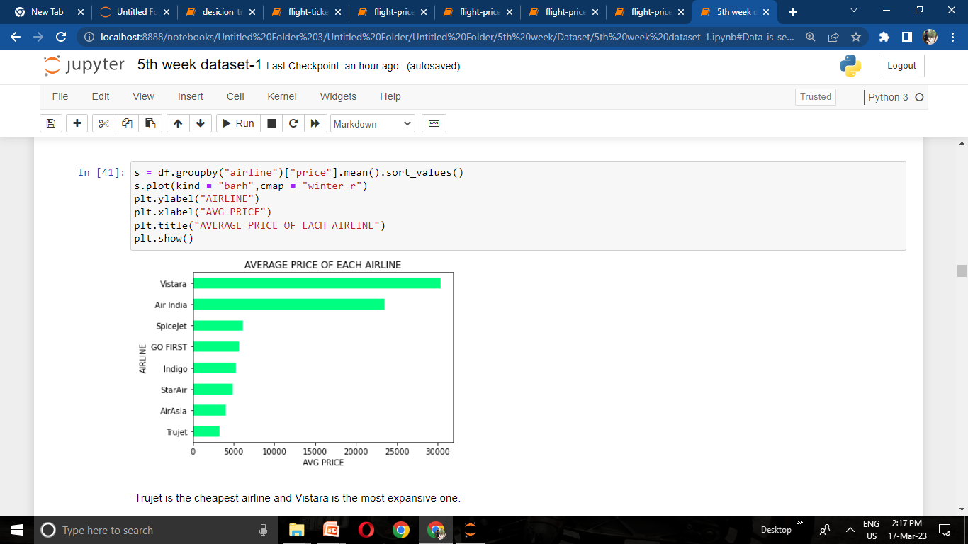
a) Does price vary with Airlines?

Slide 13
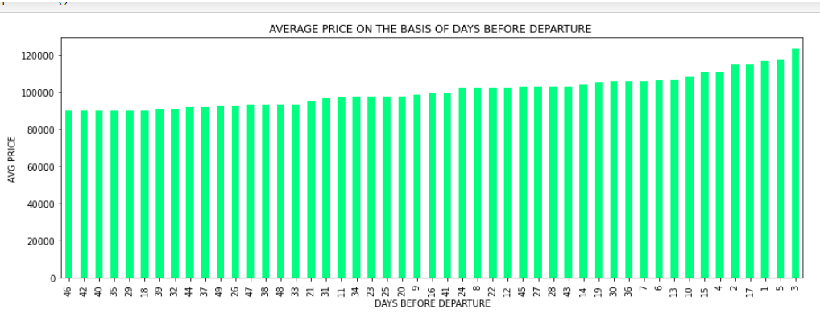
b)How is the price affected when tickets are bought in just 1 or 2 days before departure?

Slide 14
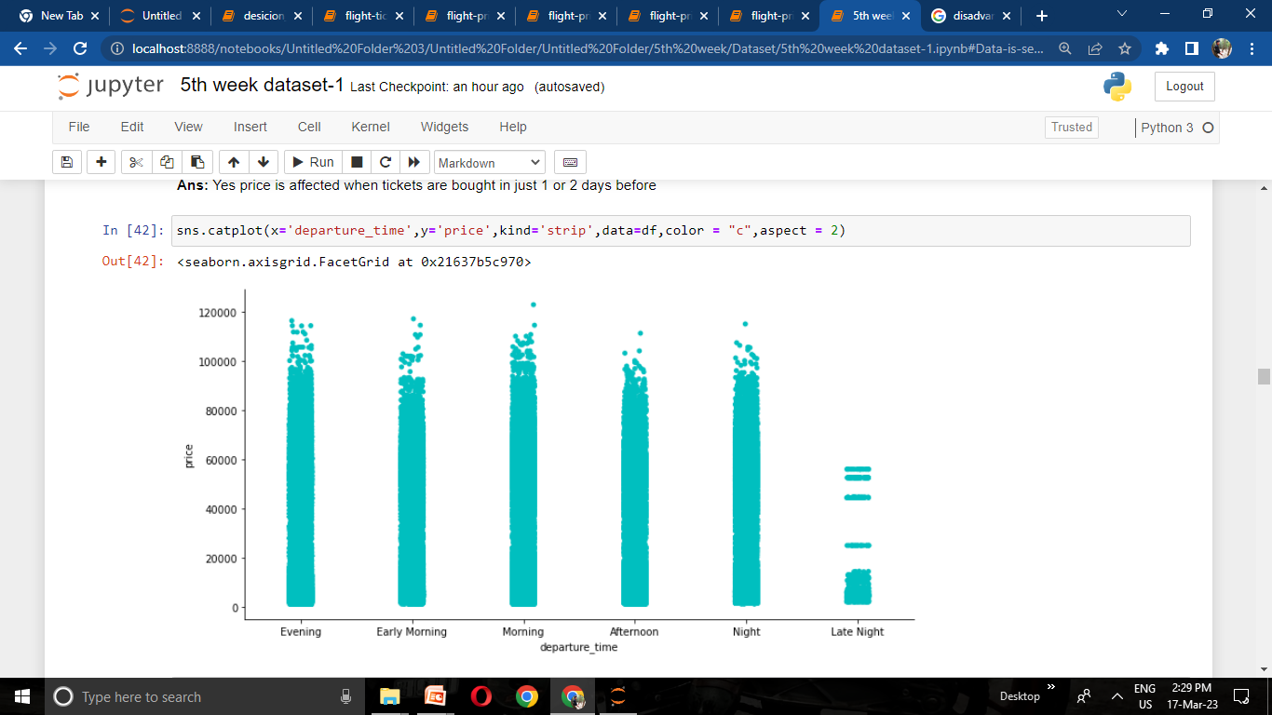
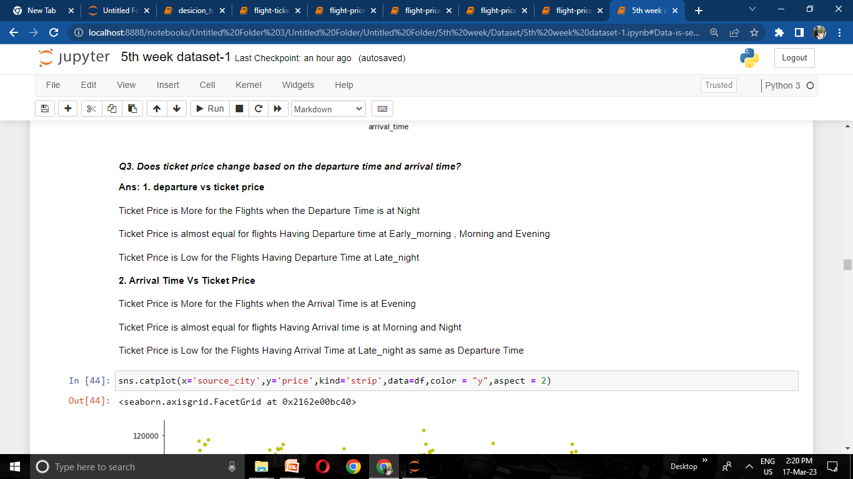
c) Does ticket price change based on the departure time and arrival time?

Slide 15
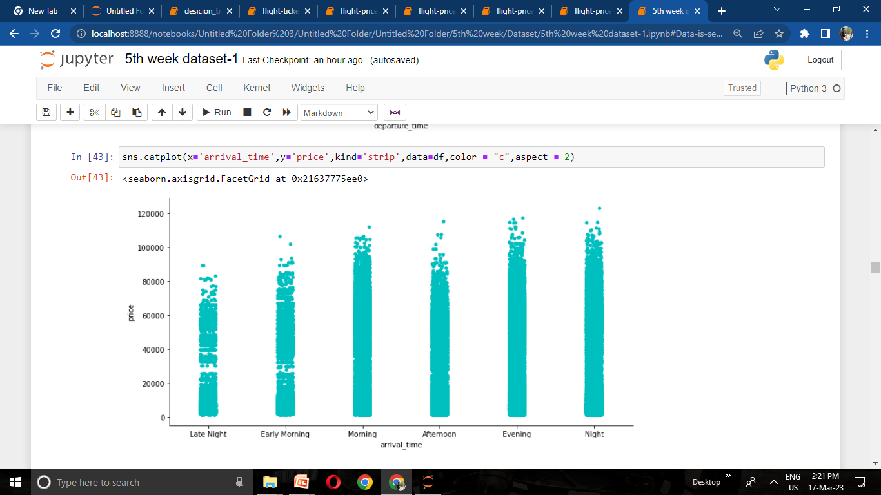

Slide 16
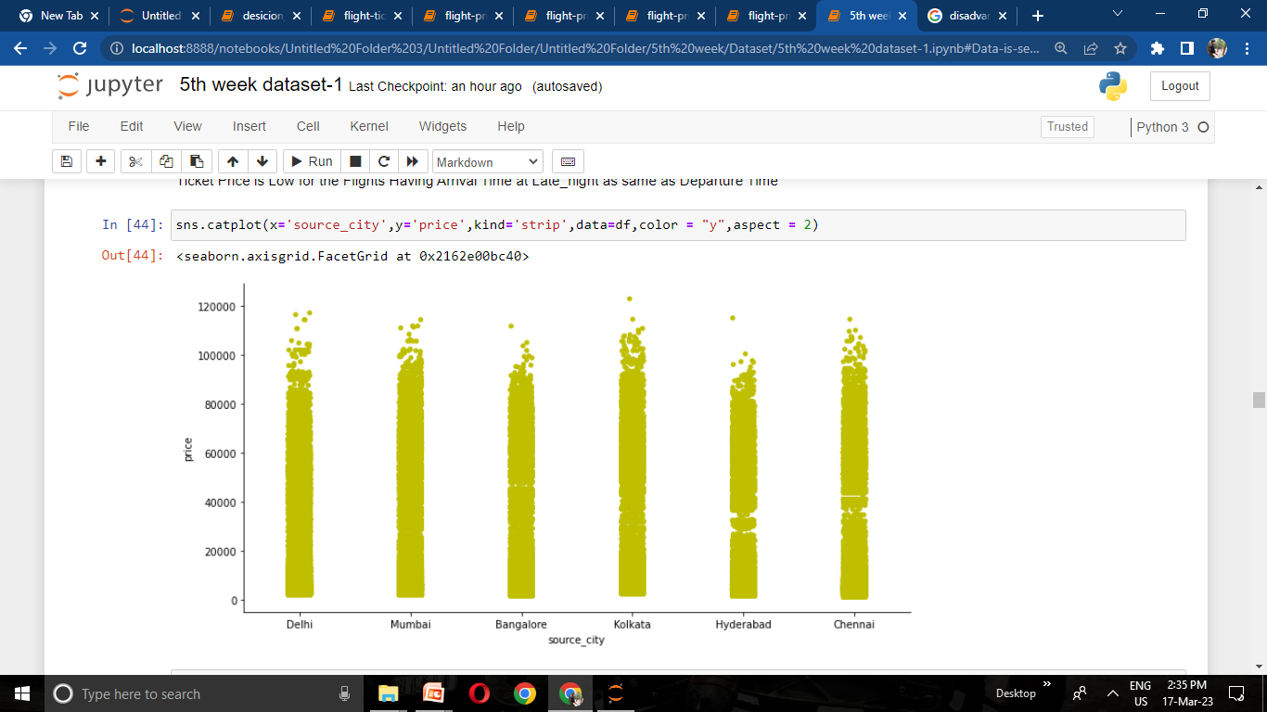
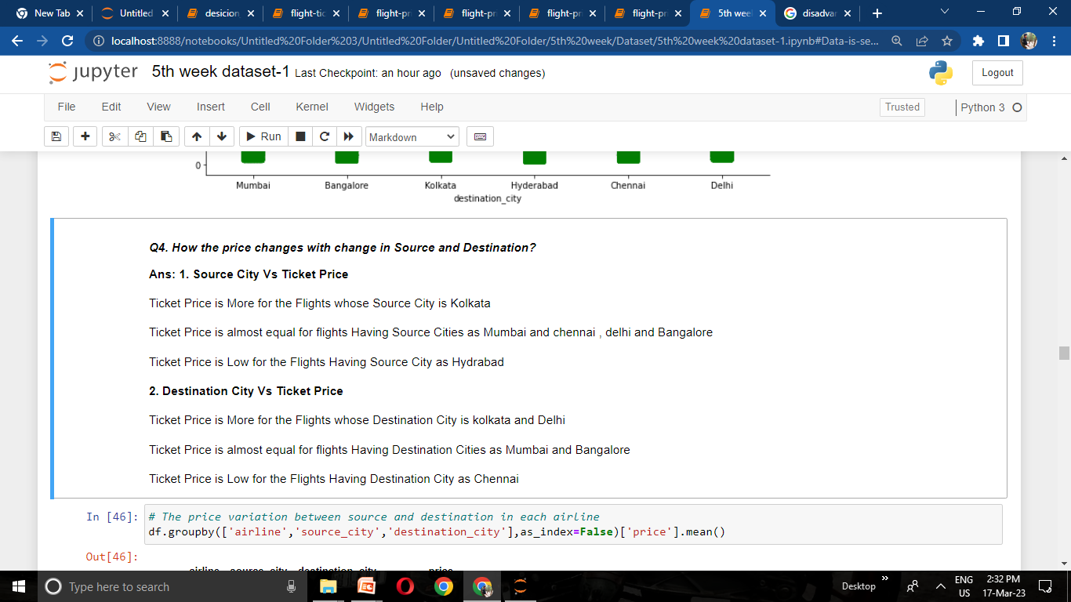
Q4. How the price changes with change in Source and Destination?

Slide 17
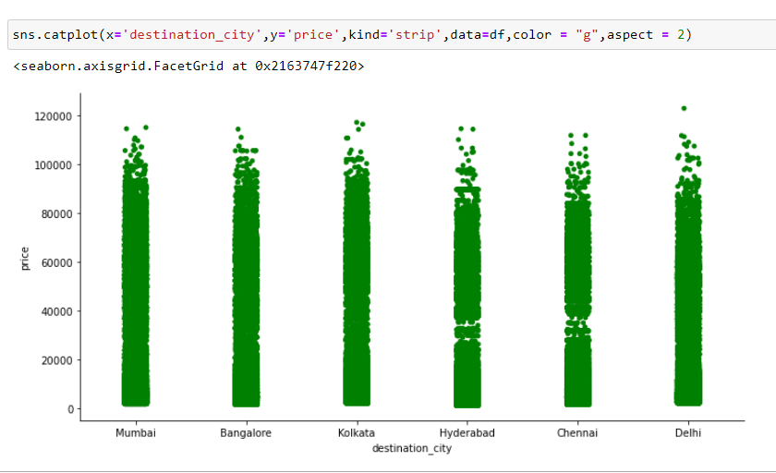

Slide 18
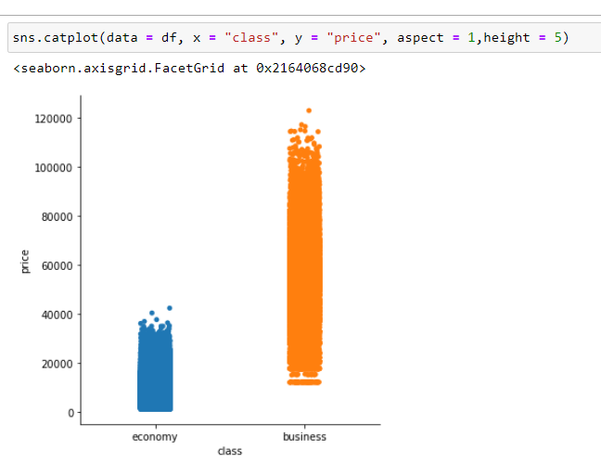
How does the ticket price vary between Economy and Business class?

Slide 19
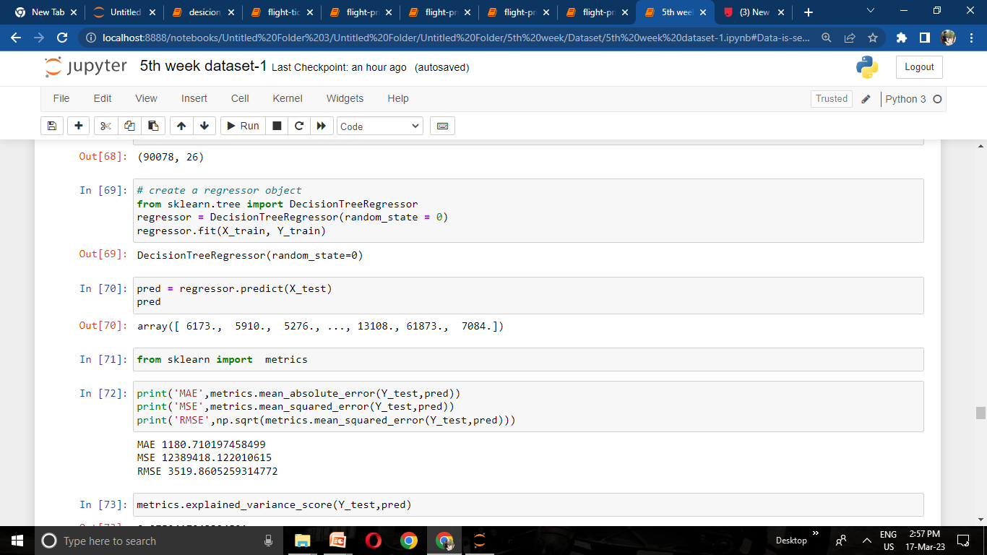
From sklearn I have imported Decision tree Regression for predicting the price

Slide 20
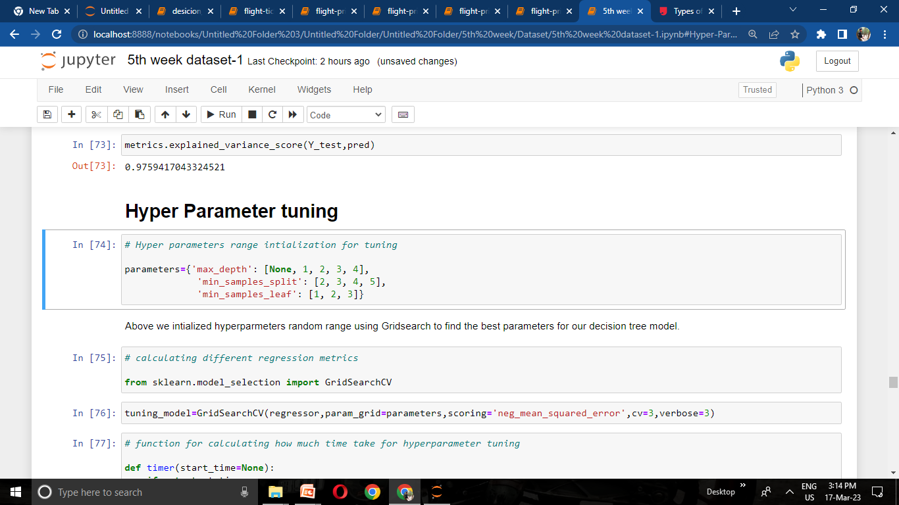
Hyper Parameter tuning
Here I initialize some random ranging as parameters for tuning my model to get better score

Slide 21
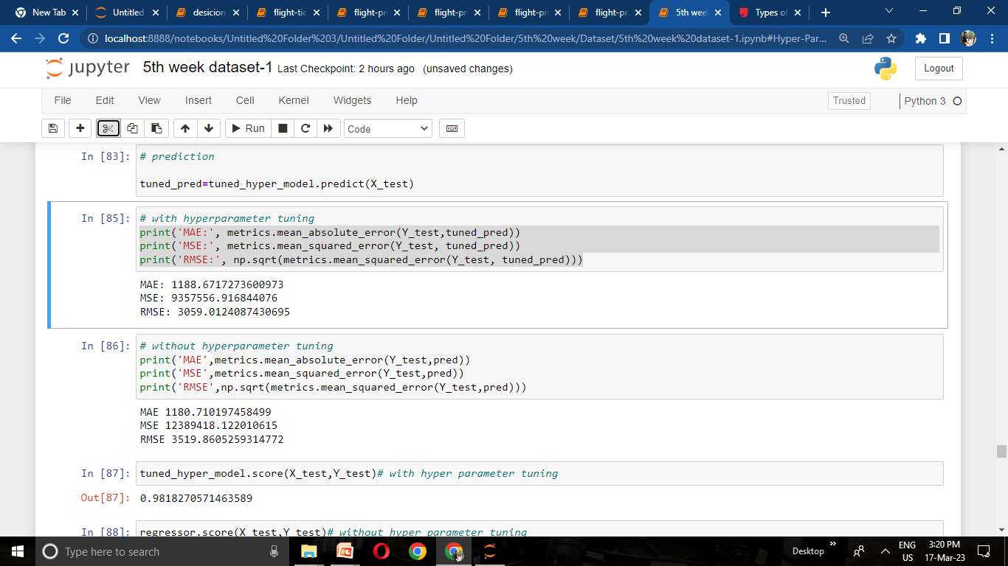
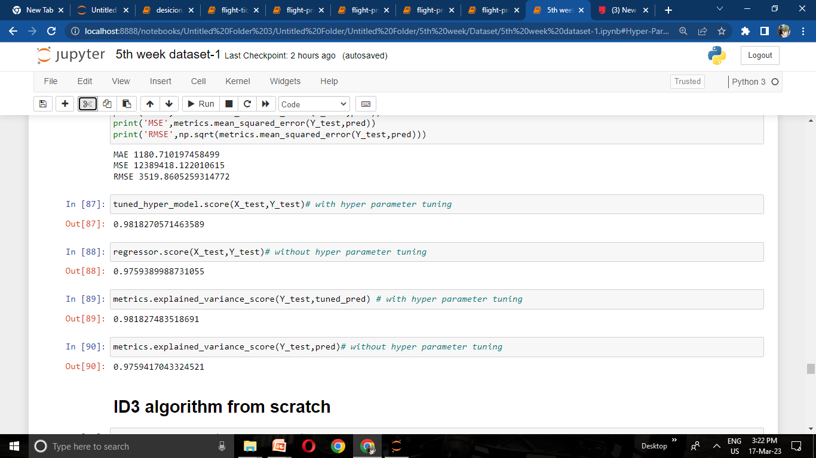
With Hyper parameter tuning
Without Hyper parameter tuning

Slide 22
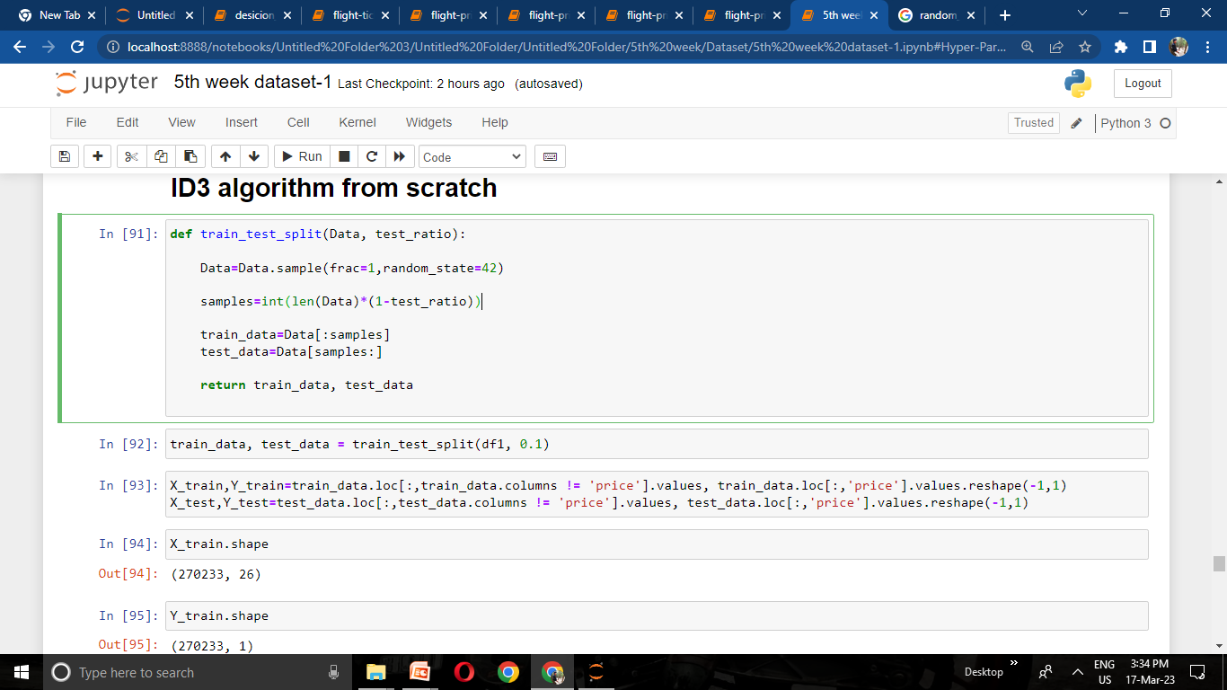
Building Tree from scratch:
In the above code I defined train and test split with test ratio of 0.1 , it means training data will be 90% and test data will be 10%

Slide 23
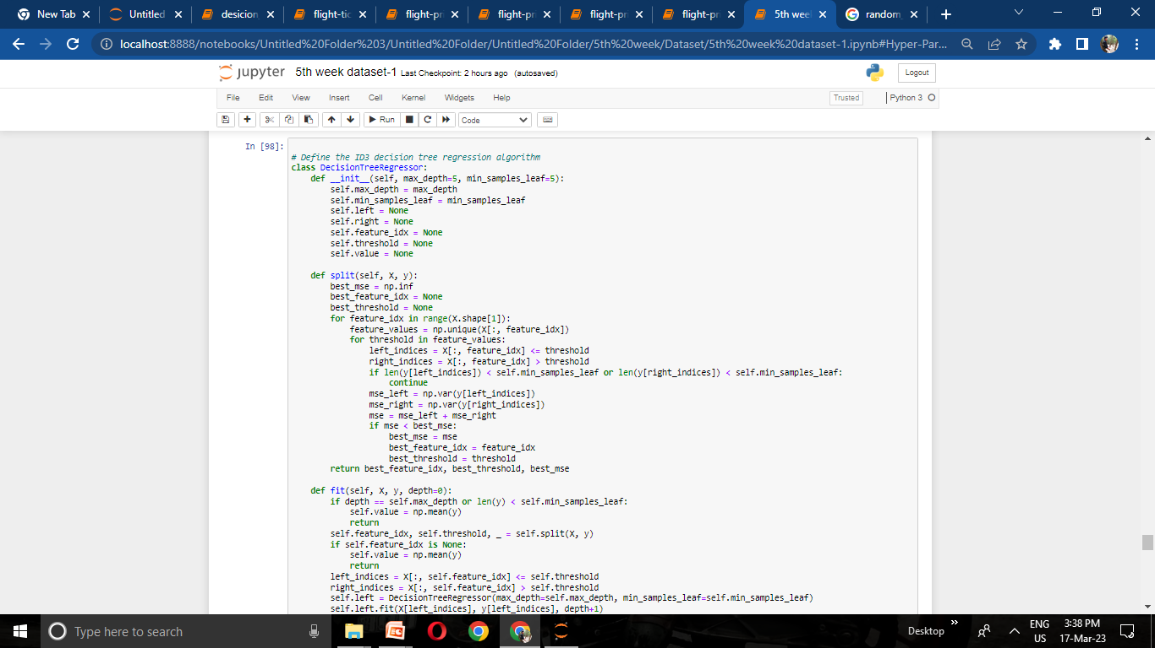
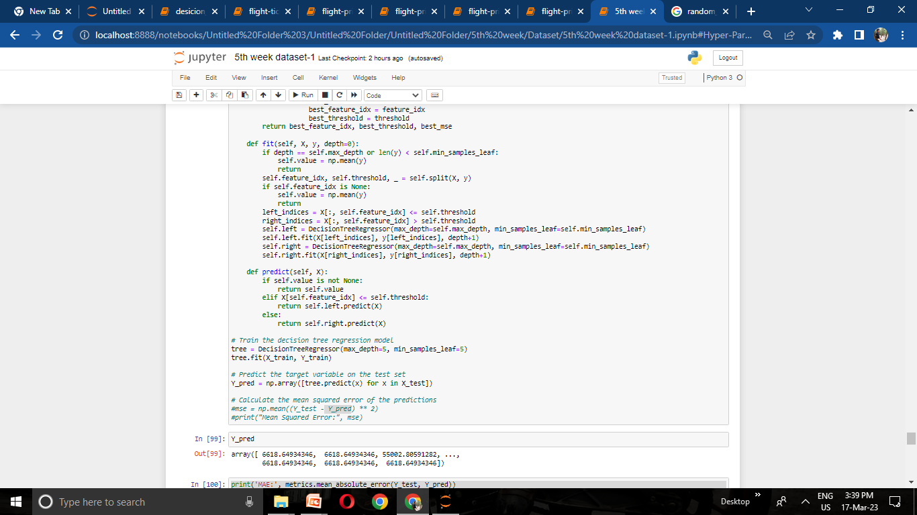

Slide 24
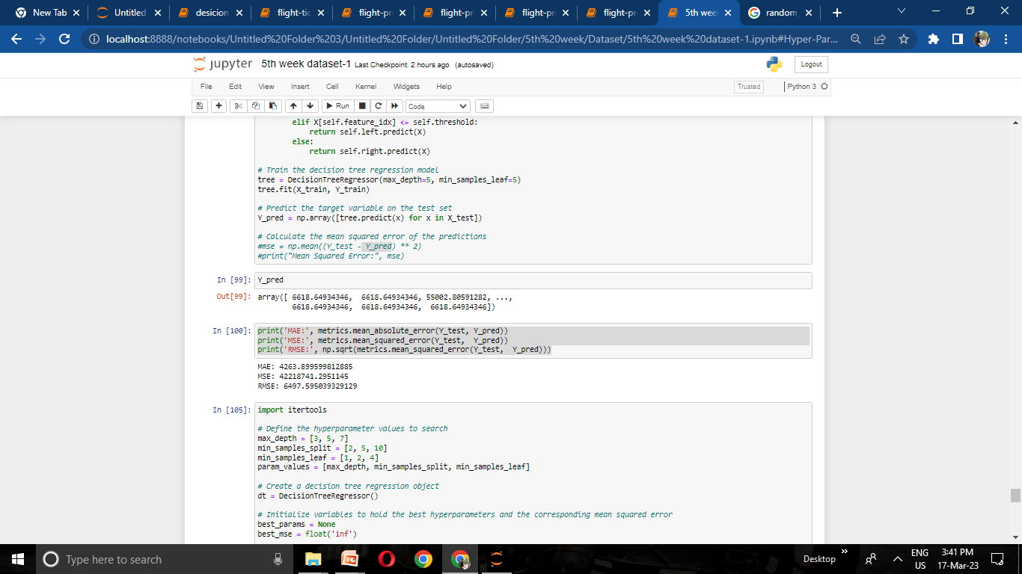
After predicting the target variable our model got
MAE = 4263.899
MSE= 42218741.29
RMSE= 6497.595

Slide 25
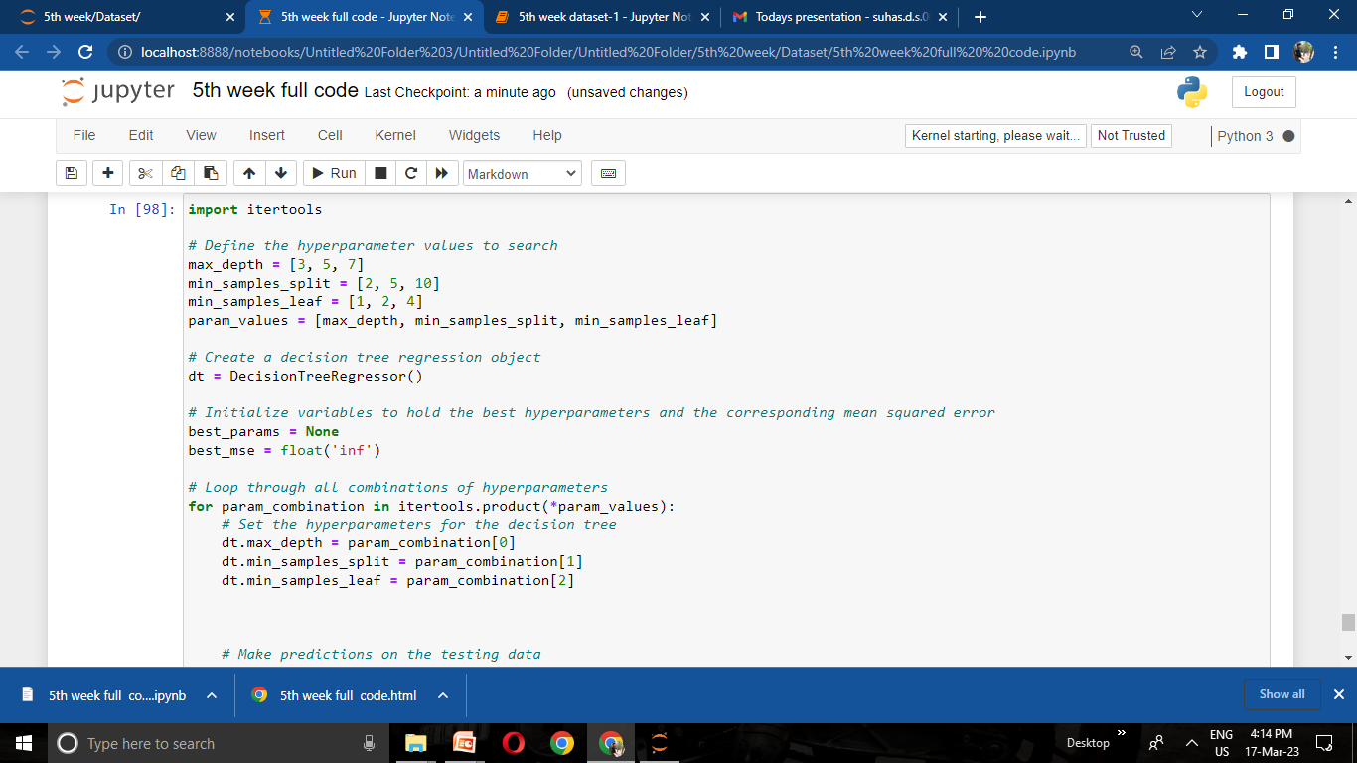
Hyper parameter tuning from scratch:

Slide 26
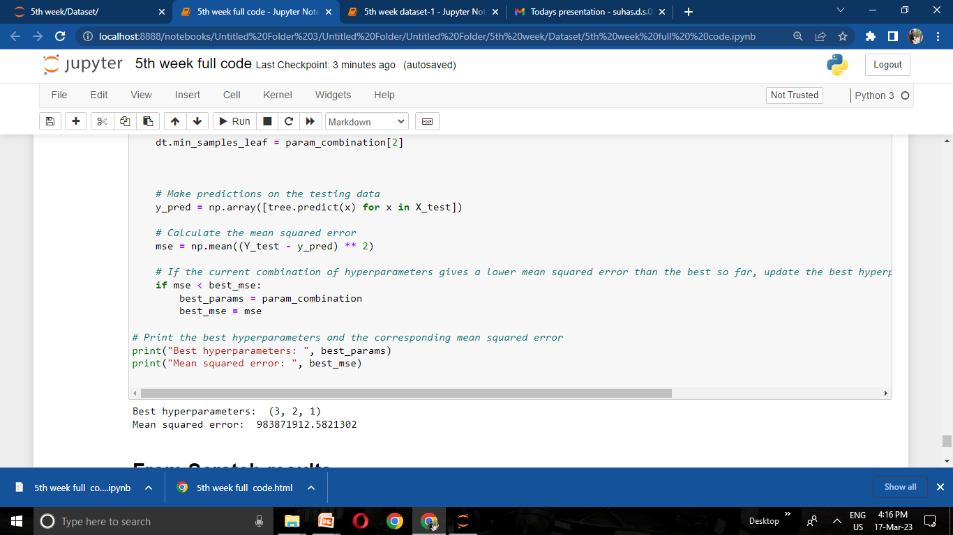

Slide 27
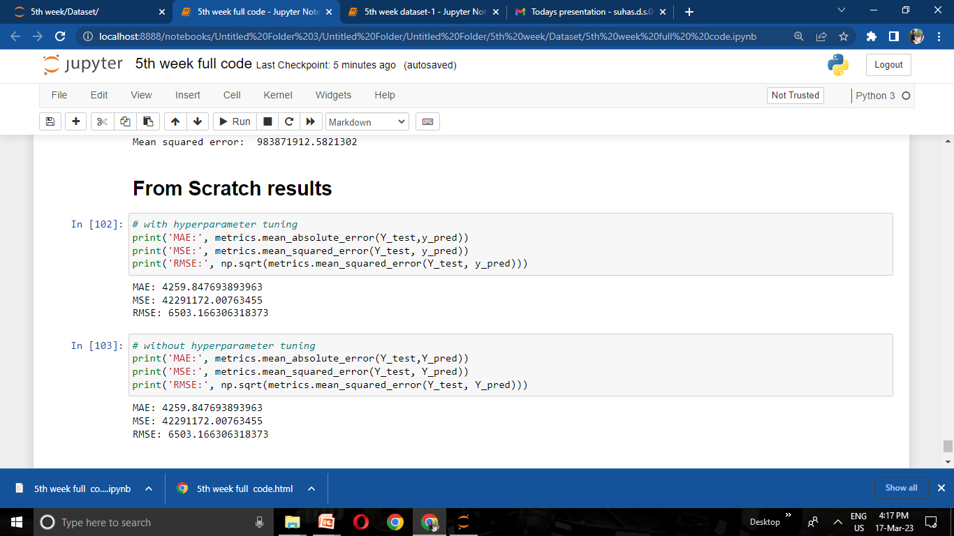
Conclusion
In this notebook i predicted the ticket price of flight from Decision tree regression using ID3 algorithm from both sklearn model and from scratch as well and got good results

Slide 28
~ THANKING YOU

